Slide 1
Software Architecture and Design
Introduction to Security
Carlos Eduardo da Silva (C.DaSilva@shu.ac.uk)
Department of Computing
College of Business, Technology and Engineering
Sheffield Hallam University

Slide 2
Plan
Main concepts
A bit of cryptography and some applications
Digital Identity Management
Authentication
Access control
On Privilege Management Infrastructure

Slide 3
Main Concepts related to Security

Slide 4
A formal definition

Slide 5

Information Security - the CIA Triad
Primary security attributes
Confidentiality
The prevention of the unauthorized disclosure of information
Integrity
The prevention of the unauthorized amendment or deletion of information
Availability
The prevention of the unauthorized withholding of information
Algirdas Avizienis, Jean-Claude Laprie, Brian Randell, and Carl Landwehr. 2004. Basic Concepts and Taxonomy of Dependable and Secure Computing. IEEE Trans. Dependable Secur. Comput. 1, 1 (January 2004), 11–33. DOI:https://doi.org/10.1109/TDSC.2004.2

Slide 6
Some secondary attributes
Accountability: availability and integrity of the identity of the person who performed an operation;
Authenticity: integrity of a message content and origin, and possibly of some other information, such as the time of emission;
Nonrepudiability: availability and integrity of the identity of the sender of a message (nonrepudiation of the origin), or of the receiver (nonrepudiation of reception).

Slide 7
It’s all about principles

Slide 8
It’s all about principles
Security is a moment in time concept
Software becomes out of date
Vulnerabilities arise
Misconfigurations aren’t realised
Bugs introduced
Misunderstandings
Single points of failure
Thus maintaining security is an ongoing process
1975, “The Protection of Information in Computer Systems.” Saltzer & Schroeder
Economy of mechanism
Fail-safe defaults
Complete mediation
Open design
Separation of privilege
Least privilege
Least common mechanism
Psychological acceptability
Continuous improvement
Least privilege
Defense in depth
Open design
Chain of control
Deny by default
Transitive trust
Separation of duty
Trust, but verify
Minimize secrets
Adopt sweeping simplifications
Least astonishment
Design for iteration

Slide 9
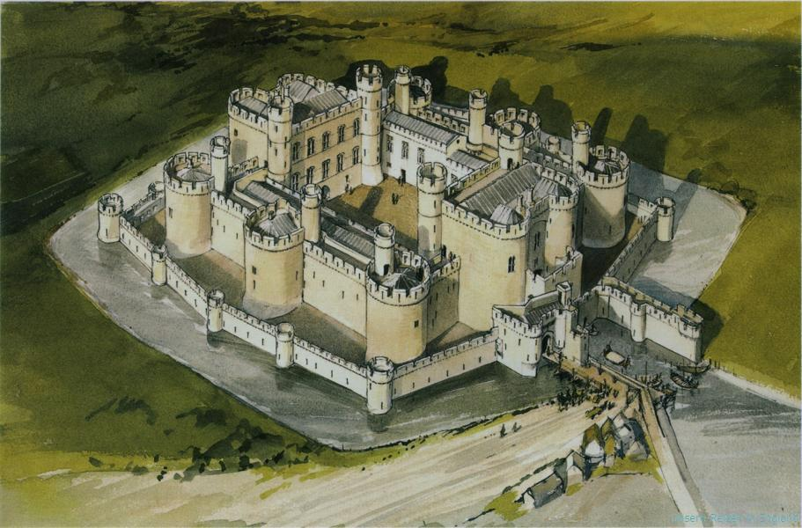
Defence in Depth
The ‘castle’ approach
https://medium.com/@sbwoodside/defence-in-depth-the-medieval-castle-approach-to-internet-security-6c8225dec294
Notes:
https://medium.com/@sbwoodside/defence-in-depth-the-medieval-castle-approach-to-internet-security-6c8225dec294
Defense 1: natural features. situated at the top of a hill, which made it easy to spot invaders, hence slowing down any attacking army, and made it difficult for attackers to move themselves and any armaments into position.
Defense 2: invade the town attached to the castle, with its own walls, defenders, and barriers. The townspeople not only defended themselves, but also alerted the castle to any incoming attacks.
Defense 3: tackle the drawbridge, potentially by building their own bridge across a moat, and then the portcullis, a heavy lattice of wood and iron that dropped down from above.
Defense 4: A good castle had two walls, with the inner wall overlooking the outer wall.
Defense 5: Assuming that they eventually penetrated the inner gate, their trials were still not over. They had merely reached the inner bailey, the place where most of the business of the castle was conducted. In the bailey were housed the horses, the training grounds, and the vegetable garden. But the lord and lady did not live in the inner bailey, they lived in the keep: a tower attached to it but separated by the final defences.
Defense 6: The keep once again could only be entered by means of a single door, reached from the bailey by a narrow stair. The keep possessed an independent well to protect from poisoning. Breaking through the thick door the attacker would find themself on a narrow spiral staircase. The spirals rose clockwise in order to force the attacker to fight left-handed — a distinct disadvantage for 90% of the population. If they were able to fight their way up several flights of stairs they would at long last find themselves face-to-face with the chests overflowing with gold and jewels, victory at hand.

Slide 10
More on the Castle
A castle
Is on a hill - natural features
Part of a town - 1st line of defence
A drawbridge to cross
Double walls to breach
Inner Bailey - not where most important people are kept
Keep - difficult to access, disadvantage for right handers to fight up
The ‘castle’ approach
No single line of defence
No one way to ‘security’
Independent
Physical controls - locked door to servers
Technical - Encryption, active directory,
Administrative - security practices & principles

Slide 11

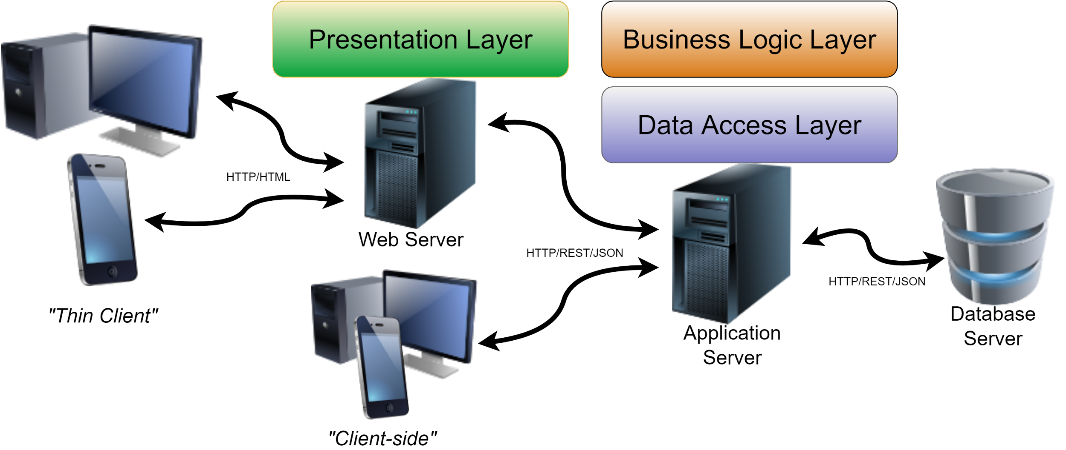
Defence in Depth

Slide 12
Enabling Technologies, AKA,
An Introduction to Cryptography

Slide 13
Introduction to Cryptography
Cryptography (cryptology)
Kryptós: "hidden"; graphein: "writing"
Techniques for hiding information
Secure communication between two parties by means of a key
Cryptanalysis
Method for obtaining the encrypted information without access to its key
How to crack encryption algorithms (or their implementations)
Steganography
Techniques for hiding a message inside another message

Slide 14
Goals of Cryptography
Hide the information from those not authorized to see it
Prevent unauthorized alteration of data
Related to identification of entities and information
Data origin authentication (origin, date, context, time)
Prevents an entity from denying previous actions
Confidentiality
Integrity
Authentication
Non-repudiation
(*) Handbook of Applied Cryptography, by A. Menezes, P. van Oorschot, and S. Vanstone, CRC Press, 1996.

Slide 15
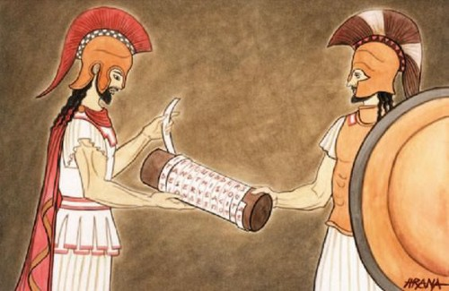
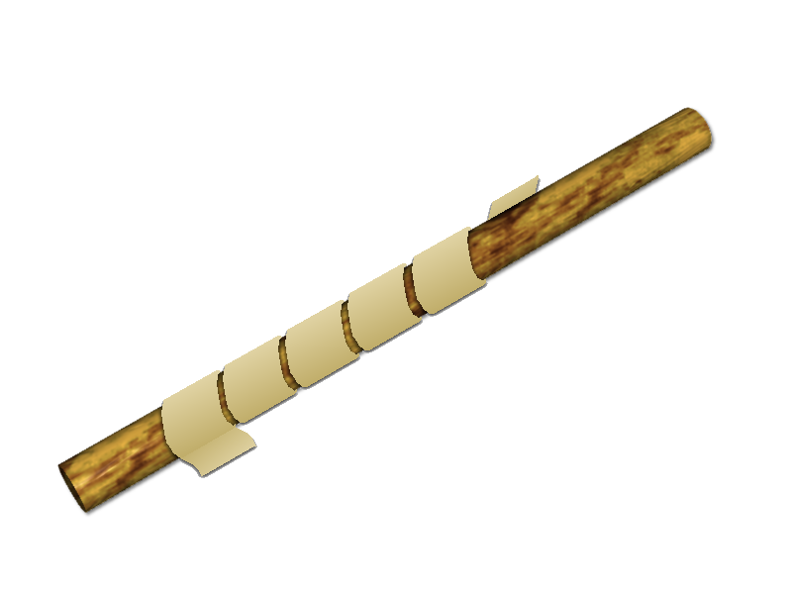
Classic Cryptography
Transposition ciphers
Rearrange order or letters
“Scytale”
Ancient Greece/Sparta 700 BC
Key is the cylinder diameter
3 letters in the circumference
W . . E . . A . . R . . E . . D . . I . . S . . C
. O . . V . . E . . R . . E . . D . . F . . L . .
. . E . . E . . A . . T . . O . . N . . C . . E .

Slide 16
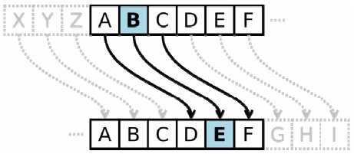
Classic Cryptography
Substitution ciphers
Monoalphabetic
Atbash Cipher
Reversed alphabet
Used to encrypt in Hebrew
600 - 500 BC
Caesar cipher - 100 BC
Shift letters (E.g., 3 letter after)
ATTACK AT DAWN
ZGGZXP ZG WZDM
The book is on the table
Uif cppl jt po uif ubcmf

Slide 17
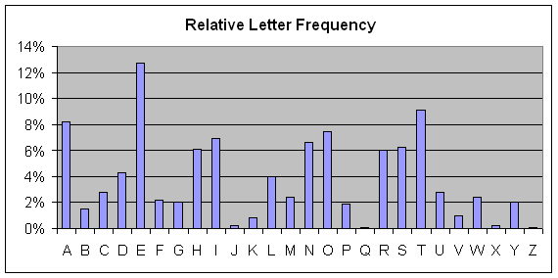
Classic Cryptography
Vulnerable to cryptanalysis
Frequency analysis technique
The book is on the table
Uif cppl jt po uif ubcmf

Slide 18
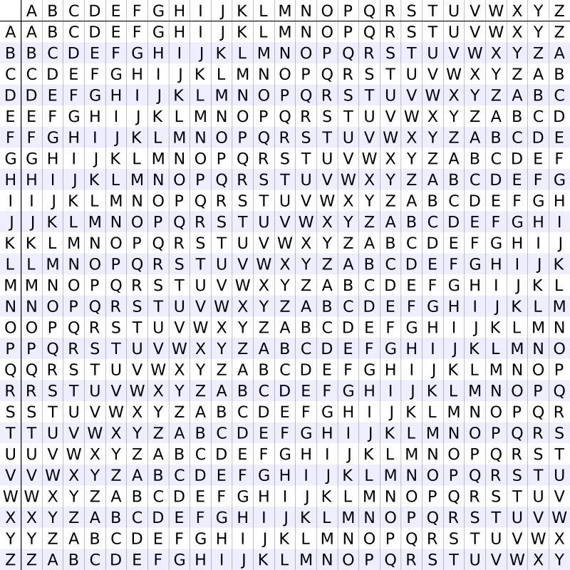
Classic Cryptography
Polyalphabetic substitution cipher
Vigenere cipher
Giovan Battista Bellaso
1553
Multiple Caesar’s ciphers
Key word used to guide cyphring
FORTIFICATION
Broken in 1863
FORTIFICATIONFORTIFICATIONFO
DEFENDTHEEASTWALLOFTHECASTLE
ISWXVIBJEXIGGBOCEWKBJEVIGGQS

Slide 19
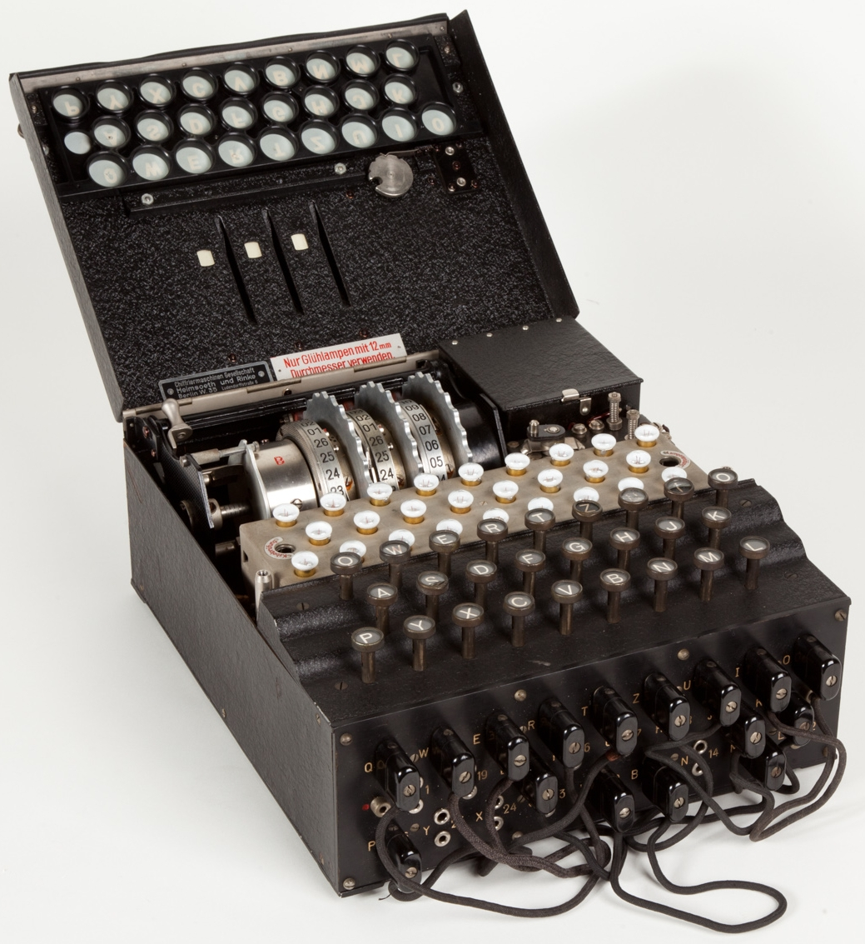
Classic Cryptography
Mechanised ciphers
Enigma Machine
“Polyalphabetic substitution” cipher
Rotors
Electric connections
Other settings
Key is the configuration settings
Only considering the lead configuration
26! / ((26 - 2L)! × L! × 2^{L})
For L=6, we have 100,391,791,500 (100 billion) combinations

Slide 20

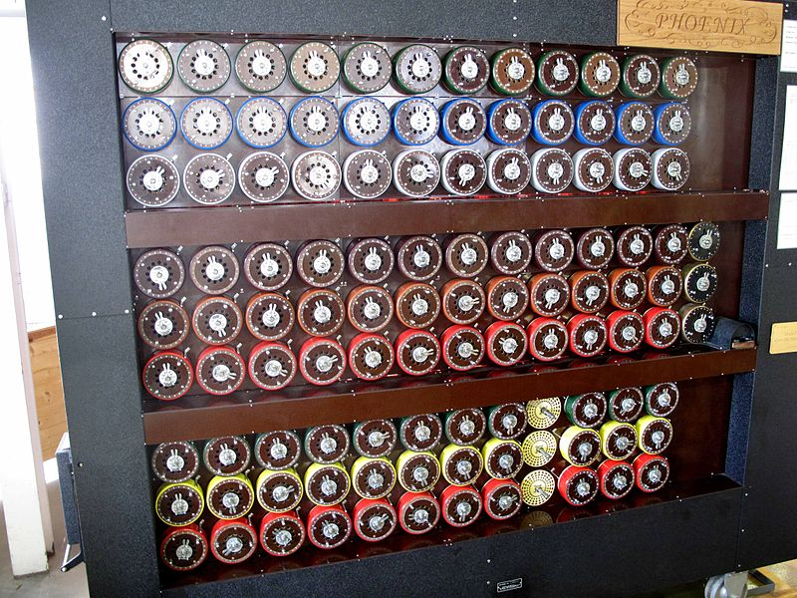
Classic Cryptography
Enigma Machine
“Broken” by the “bombe”
Helped identify the wheel order before other methods were applied
A type of “brute-force” attack

Slide 21
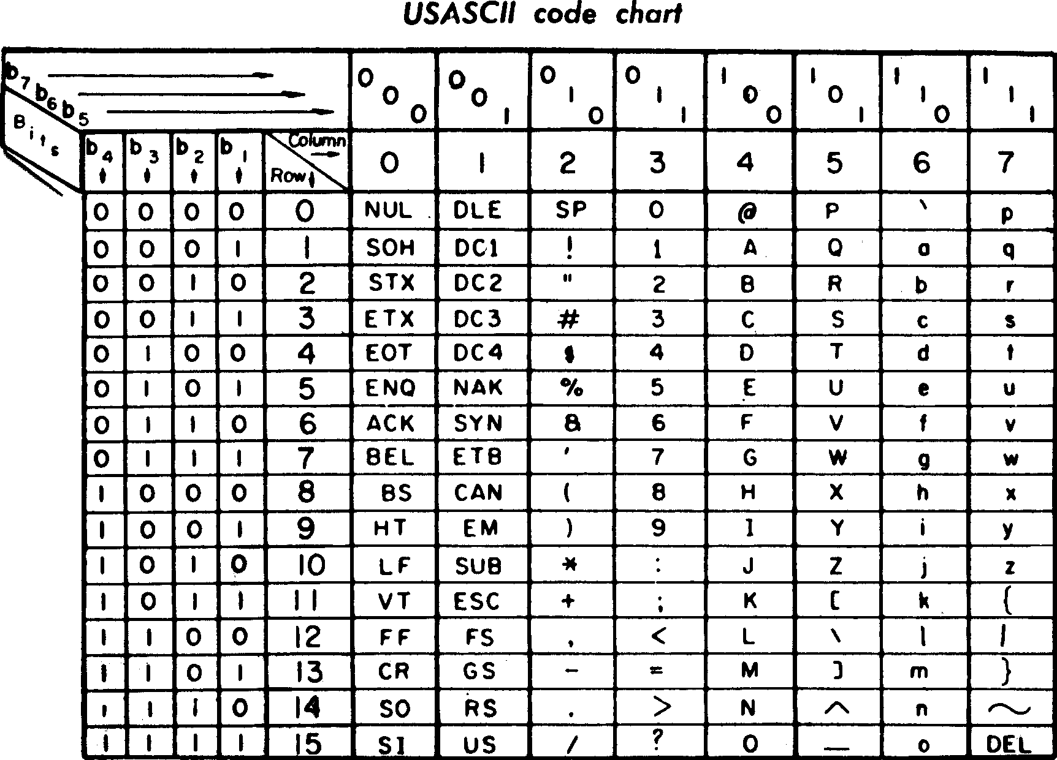
Modern Cryptography
Computer era - based on
Mathematical theory and Computer Science
Binary representation of information
Everything is a number

Slide 22
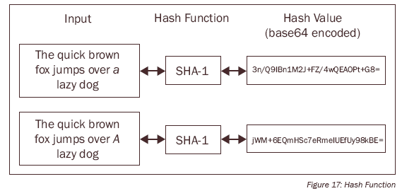
Modern Cryptography
Computer era - based on
Mathematical theory and Computer Science
Binary representation of information
Everything is a number
Encryption now is a lot of math functions
Hash
One way function that creates a fixed length hash of a message
Hash tries to uniquely identify message
Collisions
Two messages that produce the same message
A good algorithm presents low chance of collisions

Slide 23

Modern Cryptography
Computer era - based on
Computational Complexity Theory: Computational Hardness
“a particular problem cannot be solved efficiently (where efficiently typically means "in polynomial time")”
Integer (prime) factorisation
Discrete logarithm
In 2019, Boudot et al. factored a 240-digit number utilizing approximately 900 core-years of computing power
Notes:
Core year: The equivalent of using 1 CPU core continuously for a full year. Using 12 cores for a month, or 365 cores for a single day are both equivalent to 1 core-year

Slide 24
Dealing with keys

Slide 25
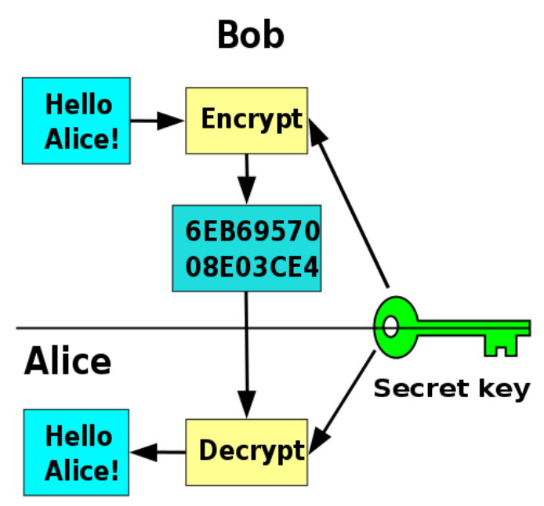
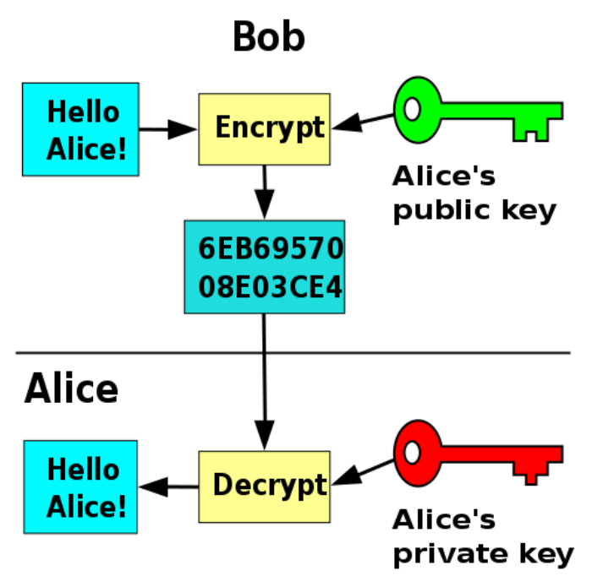
Cryptography Keys
Symmetric
Asymmetric

Slide 26
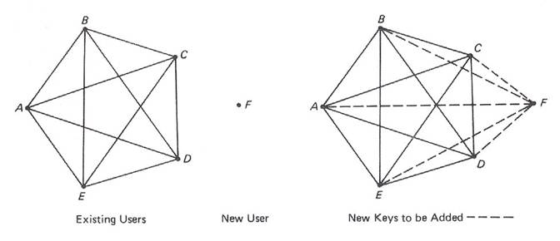
Symmetric Key Problem
For n people, we need n(n-1)/2 keys
Notes:
Single use key pad (notebook)

Slide 27
Examples of applications
Confidentiality
Authentication/Integrity
Non-repudiation
...of origin
Encrypt with public key
Decrypt with private key
Digital Signature
Sign message with private key
Anyone can verify with public key
Secure e-mails
PGP - Pretty Good Privacy
OpenPGP/GnuPG
protonmail.com
Used in smartcards
Credit cards
e-Passports
Web certificate

Slide 28
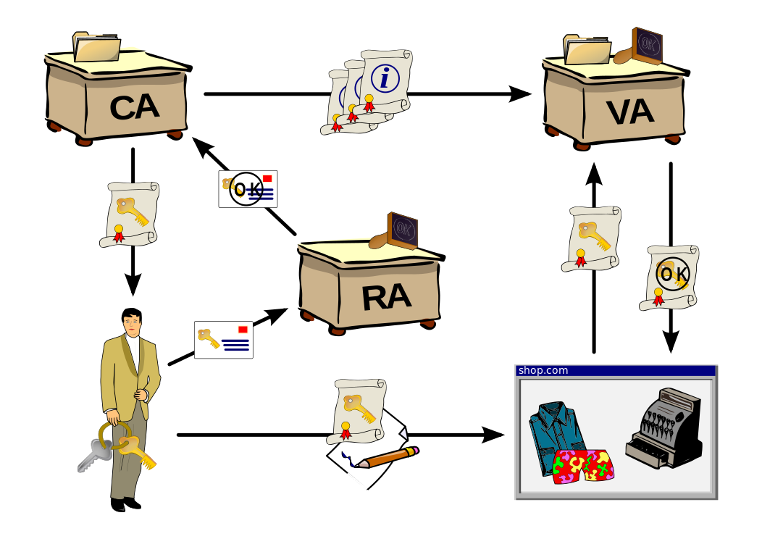
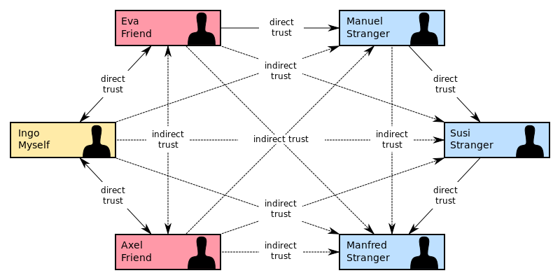
How can you trust the key?
Web of Trust
Public Key Infrastructure
Notes:
https://csrc.nist.gov/csrc/media/projects/forum/documents/2012/october-2012_fcsm_pturner.pdf
https://sslmate.com/resources/certificate_authority_failures
https://en.wikipedia.org/wiki/DigiNotar

Slide 29


Slide 30
Digital Identity Management

Slide 31
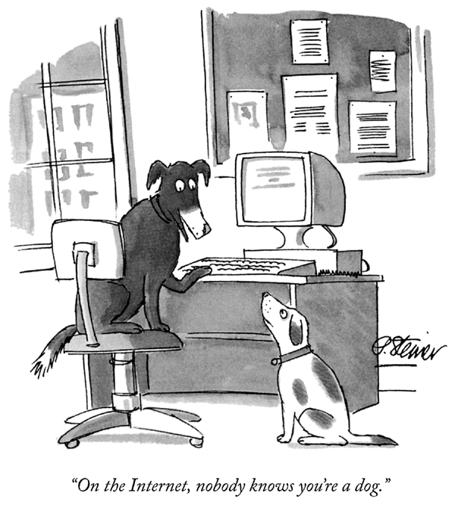
Cartoon by Peter Steiner,
The New Yorker, July 5, 1993

Slide 32
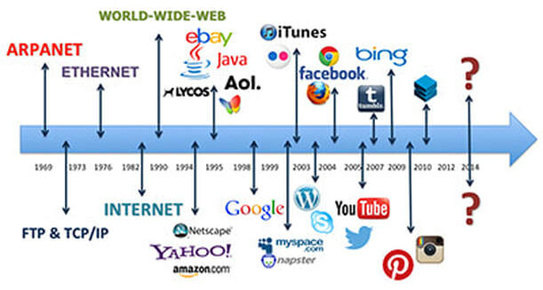
Internet Evolution
http://digiwonderz.weebly.com/the-internet-for-business/the-evolution-of-the-internet

Slide 33
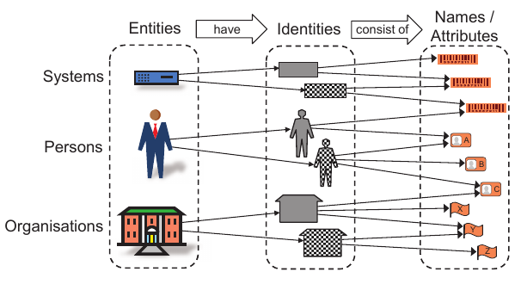
Digital Identity Concepts
Jøsang, A. Identity management and trusted interaction in Internet and mobile computing
IET Information Security, Institution of Engineering and Technology, 2014, 8, 67-79
Notes:
Digital identity:
A set of attributes that together characterize an entity in a given context, allowing the unique identification of this entity in this context
Entity:
An individual, a network service, a device, an institution
Attribute:
A property, quality or characteristic of an entity
Identifier:
A set of attribute(s) that uniquely identifies an entity in a particular Domain.
Must be exclusive in the context (e.g., a primary key in a database)
Identification:
Process of linking an entity to a digital identity. The action of an entity claiming an identity to the system through an identifier

Slide 34


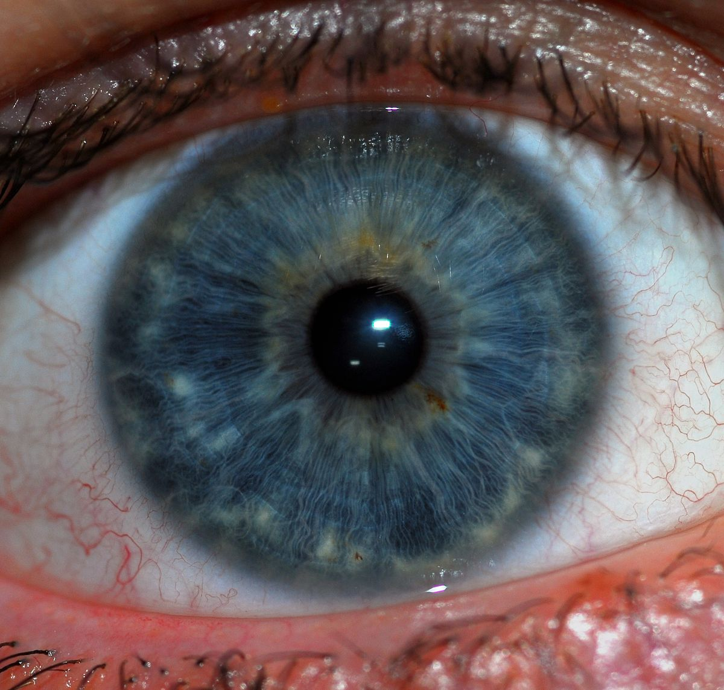
Digital Identity Concepts
Jøsang, A. Identity management and trusted interaction in Internet and mobile computing
IET Information Security, Institution of Engineering and Technology, 2014, 8, 67-79
Notes:
Digital identity:
A set of attributes that together characterize an entity in a given context, allowing the unique identification of this entity in this context
Entity:
An individual, a network service, a device, an institution
Attribute:
A property, quality or characteristic of an entity
Identifier:
A set of attribute(s) that uniquely identifies an entity in a particular Domain.
Must be exclusive in the context (e.g., a primary key in a database)
Identification:
Process of linking an entity to a digital identity. The action of an entity claiming an identity to the system through an identifier

Slide 35


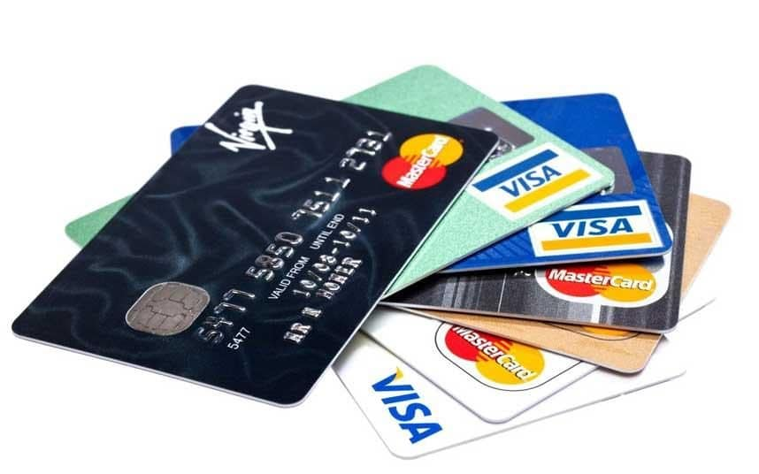
Digital Identity Concepts
Jøsang, A. Identity management and trusted interaction in Internet and mobile computing
IET Information Security, Institution of Engineering and Technology, 2014, 8, 67-79
Notes:
Digital identity:
A set of attributes that together characterize an entity in a given context, allowing the unique identification of this entity in this context
Entity:
An individual, a network service, a device, an institution
Attribute:
A property, quality or characteristic of an entity
Identifier:
A set of attribute(s) that uniquely identifies an entity in a particular Domain.
Must be exclusive in the context (e.g., a primary key in a database)
Identification:
Process of linking an entity to a digital identity. The action of an entity claiming an identity to the system through an identifier

Slide 36
General Data Protection Regulation
It’s the law
Ensure protection for the individual regarding the processing of its data by organisations
Explicit consent needed (informed, unambiguous opt-in, freely given, informed, withdrawable, documented)
Personable Identifiable Information
Can you identify a living individual from the data?
Does the data tell you something about that individual?
Privacy Notice
Describes how/why data will be processed
E.g., https://www.shu.ac.uk/about-this-website/privacy-policy
Enforceable
Information Commissioner's Office

Slide 37
General Data Protection Regulation
How does it affect me as a developer?
Consider the rights of data subjects
Informed, subject access requests, rectification, erasure, …
Anonymisation and Pseudonymisation
Can you identify an individual from the data? What about crossing with other available data?
Be aware of your company’s procedures
Data breach: In doubt, shout out!!!
Example: SHU
Privacy policy and Cyber Awareness course
Some systems are not available outside SHU
Sharing data outside Uni

Slide 38


Slide 39
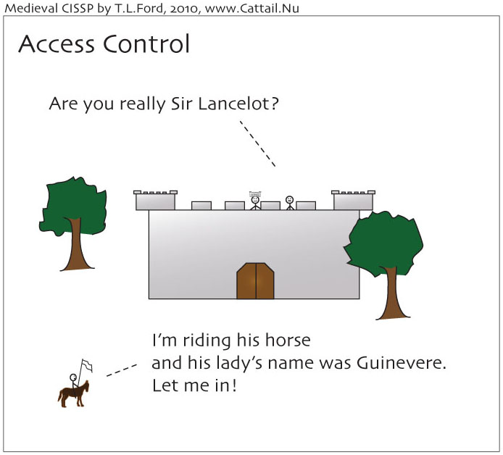
On Access Control Mechanisms

Slide 40
On Access Control Mechanisms
Authentication

Slide 41
On Access Control Mechanisms
Authentication
Authorization

Slide 42
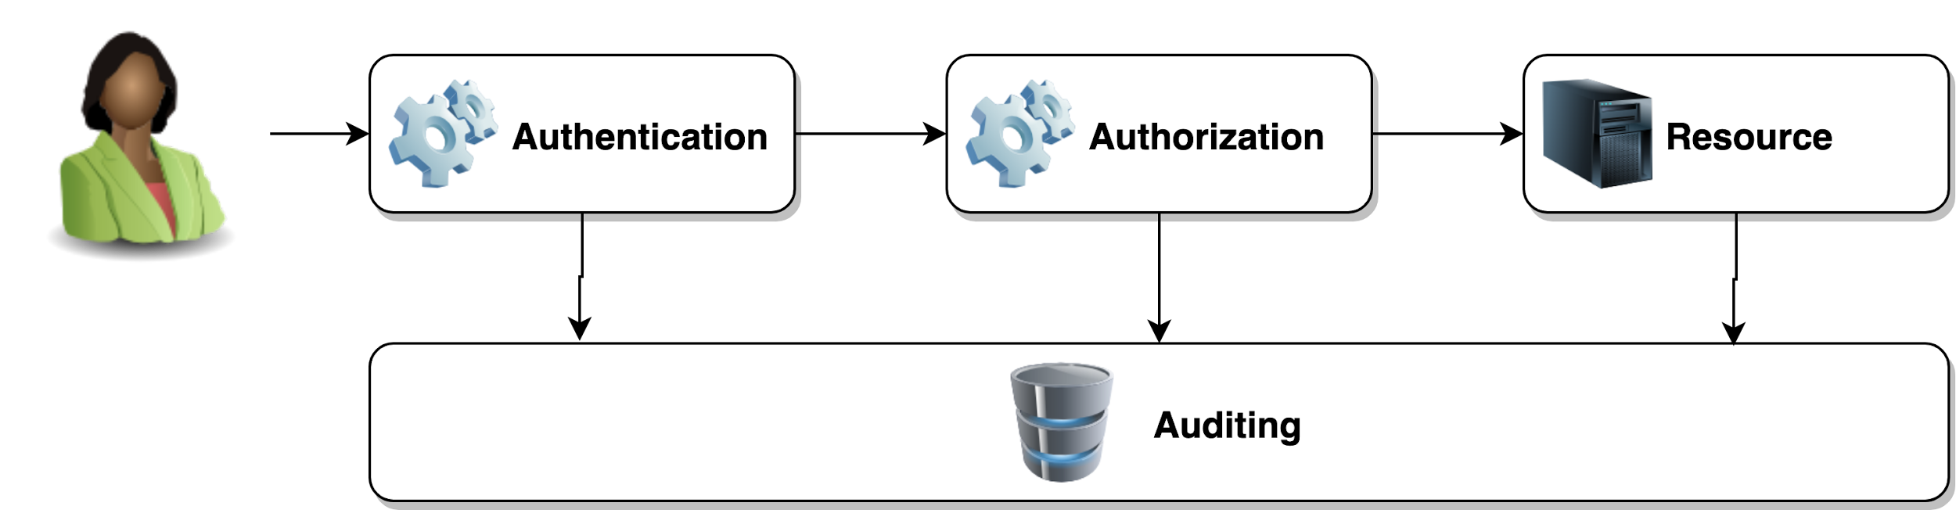
The AAA framework
* Some documents refer to “accounting and auditing” or only accounting
E.g., RFC2904, Radius
Notes:
Authentication
Proving that the entity has the right to the claimed identity
The process of verifying the identity claimed by an entity based on its credentials
Authorization
Process of determining if an user has the right to access a requested resource
It is the action of the system in providing privileges to an entity after authentication of its identity
Auditing
Registration of what the entity has done for posteriori analysis of all the requests and activities of the user in the system
Can be used as means for accountability, billing and analysis of user behaviour

Slide 43
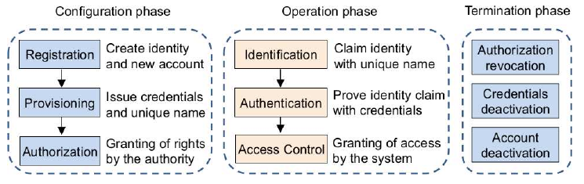
The AAA framework
Jøsang, A. A Consistent Definition of Authorization
13th International Workshop on Security and Trust Management (STM 2017), Springer International Publishing, 2017, 134-144
Notes:
Authentication
Proving that the entity has the right to the claimed identity
The process of verifying the identity claimed by an entity based on its credentials
Authorization
Process of determining if an user has the right to access a requested resource
It is the action of the system in providing privileges to an entity after authentication of its identity
Auditing
Registration of what the entity has done for posteriori analysis of all the requests and activities of the user in the system
Can be used as means for accountability, billing and analysis of user behaviour

Slide 44
Authentication
Lots of talk about using two-factor authentication but what is a factor?
Something a user knows - e.g., password, PIN
Something a user has - e.g., smart card, key fob
Something a use is - e.g., fingerprint (biometric)

Slide 45
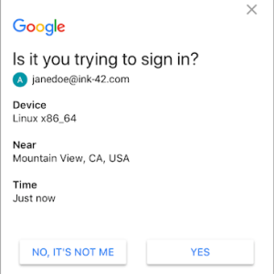
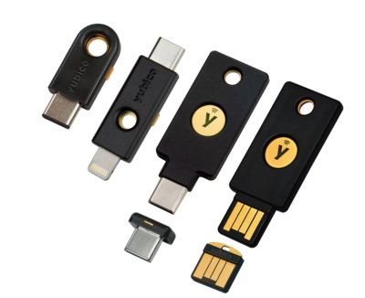
Authentication
Lots of talk about using two-factor authentication but what is a factor?
Something a user knows - e.g., password, PIN
Something a user has - e.g., smart card, key fob
Something a use is - e.g., fingerprint (biometric)
https://securityaffairs.co/wordpress/71572/mobile-2/google-prompt-ios.html
https://www.yubico.com/

Slide 46
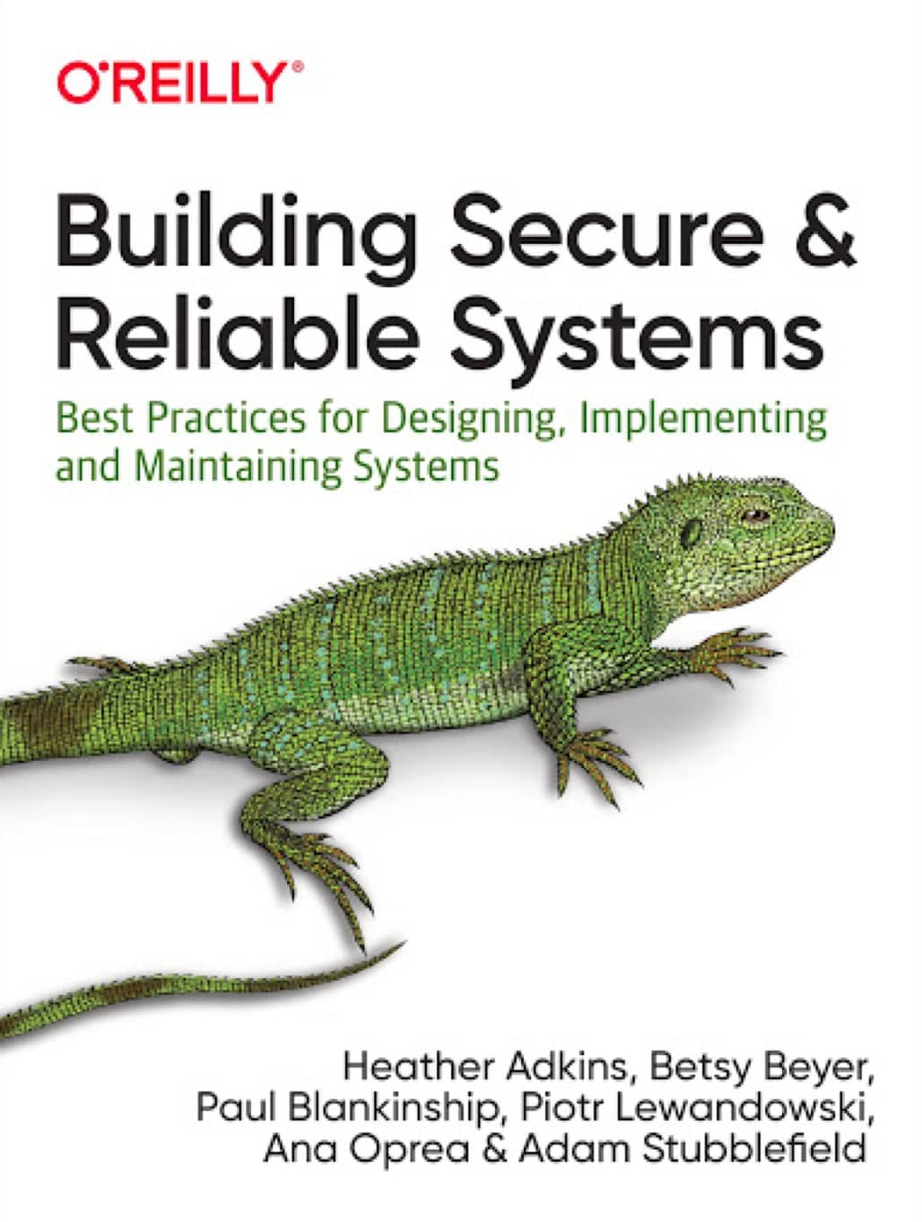
Authentication
Lots of talk about using two-factor authentication but what is a factor?
Something a user knows - e.g., password, PIN
Something a user has - e.g., smart card, key fob
Something a use is - e.g., fingerprint (biometric)
Example that are NOT authentication
Where you are (a possible 4th factor)
Someone a user knows
Designated person gives permission
Interesting reading:
(Chapter 5)

Slide 48
Authorization and Access Control
There is mixed understanding of these terms
Authorization != Access Control
Definition 1: Authorization is the specification of access policies.
Definition 2: Access control is the enforcement of access policies.
Jøsang, A. A Consistent Definition of Authorization
13th International Workshop on Security and Trust Management (STM 2017), Springer International Publishing, 2017, 134-144

Slide 49
Access Control Models
Mandatory Access Control - found in military / government based on Unclassified, Restricted, Confidential, Secret, Top Secret. Access permission are set against this model
Discretionary Access Control - Owner of a resource enables user to have access
Role-based Access Control - Access permission is based on the work a person does inside an organisation, i.e., their role
Attribute-based Access Control - Access permission is based on user attributes
Notes:
https://en.wikipedia.org/wiki/Access_control#Access_control_models

Slide 50
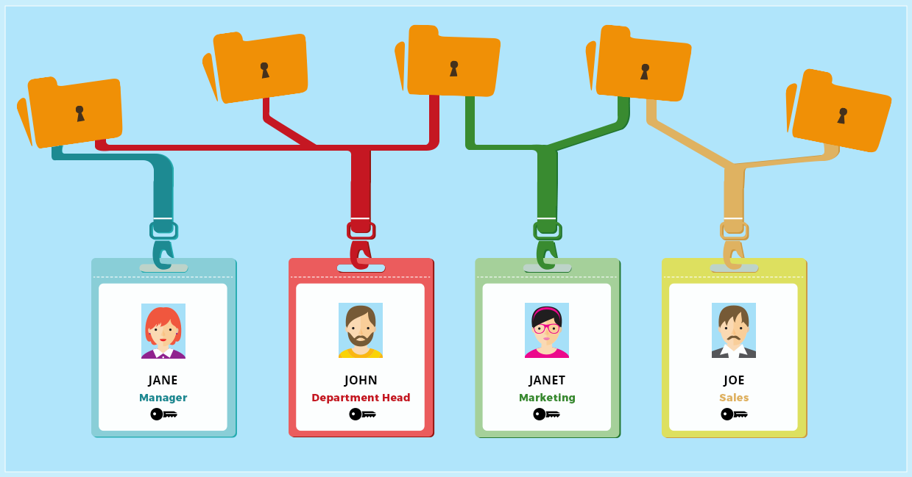
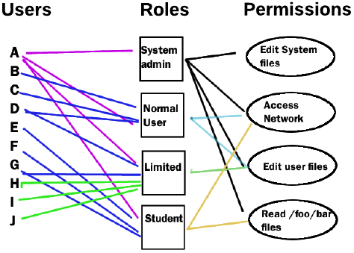
RBAC Access Control Model
source: https://kissflow.com/bpm/bpm-access-controls-scenarios/
Access is granted or denied based on access control policies
RBAC: Users x Roles x Permissions

Slide 51
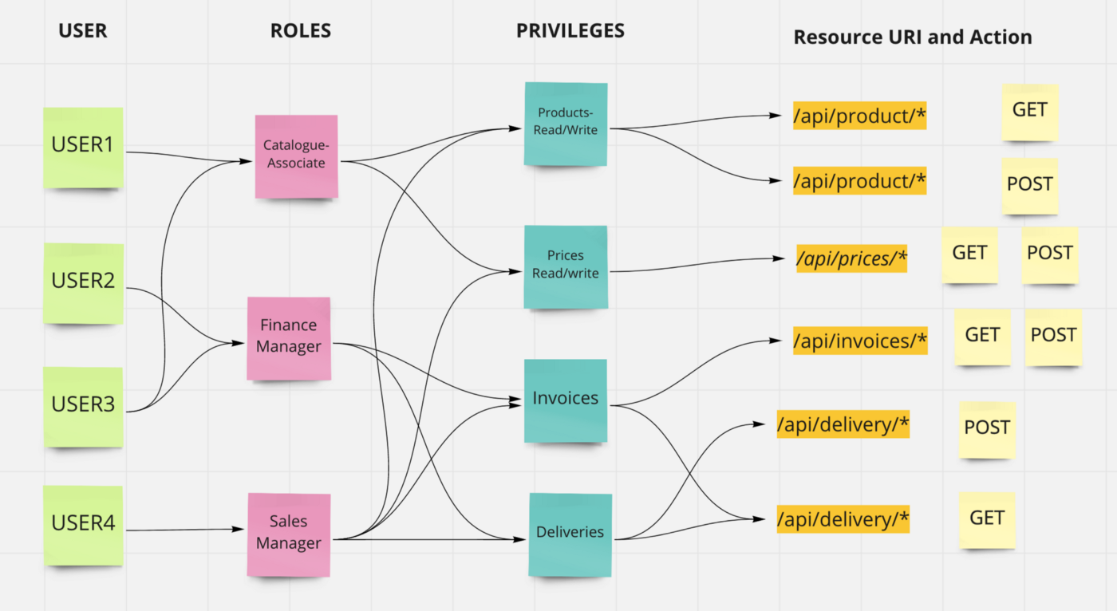
RBAC Access Control Model
https://atuldewangan.medium.com/role-based-access-control-rbac-476452806518
Notes:
RBAC is not enough
Groups of devices (per clients), groups of users, hierarchy, time constraints, …

Slide 52
On Access Control Models
Sometimes RBAC is not enough
AA can see attendance information of its advisees
E.g.: GET /attendance/student123
…but not for all students
Need to check whether student123 is an advisee of the requestor
Role Based Access Control Policy Enhanced (NIST INCITS 494-2012)
Extends RBAC with information like time of day, user location, parameters/attributes of objects, …
Attribute Based Access Control (NIST SP 800-162, 2014)
AC policies are defined with logical expressions based on attributes
“Role” is just another attribute

Slide 53
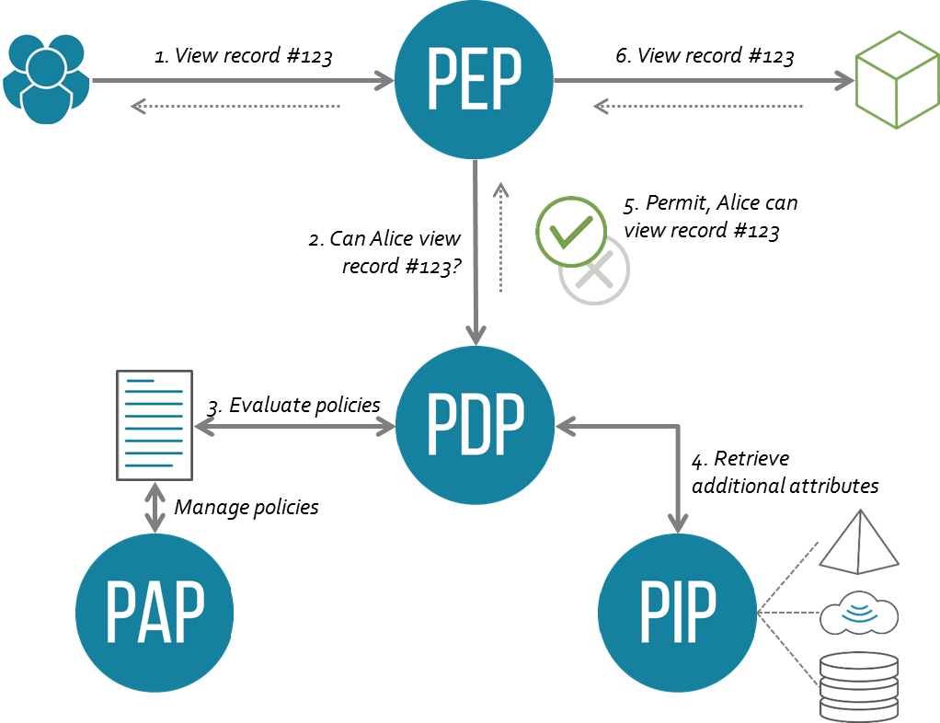
ABAC Access Control Model
Attributes of subject, object, environment, operation, …
Functional components
PEP - Policy Enforcement Point
PDP - Policy Decision Point
PIP - Policy Information Point
PAP - Policy Administration Point
eXtensible Access Control Markup Language (XACML)
The most used, but very complex
Allow access to
resource MedicalJournal
with attribute patientID=x
if Subject match DesignatedDoctorOfPatient
and action is read
Notes:
https://medium.com/identity-beyond-borders/a-beginners-guide-to-xacml-6dc75b547d55

Slide 55
Privilege Management Infrastructure

Slide 56
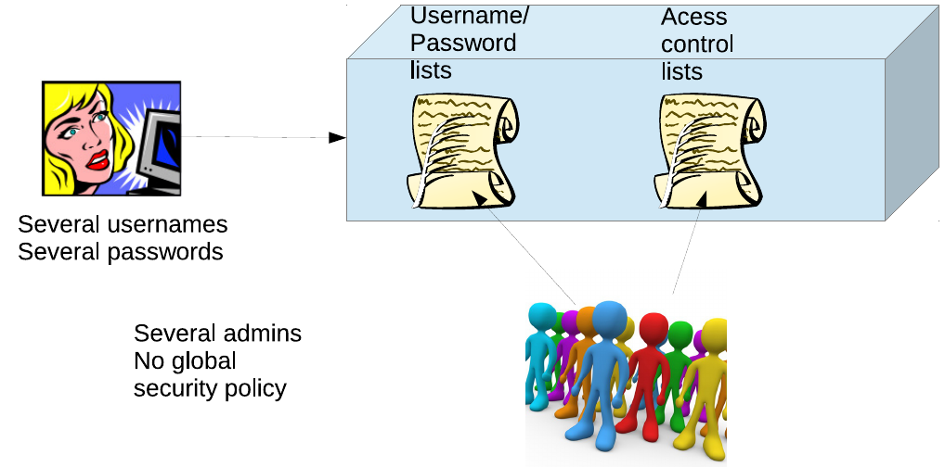
Privilege Management Infrastructure
Authentication and Access Control internal to application

Slide 57
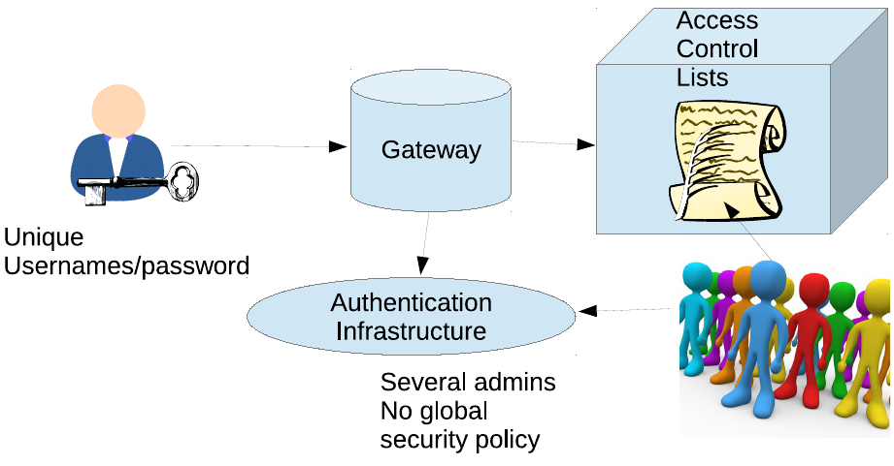
Privilege Management Infrastructure
Authentication external to application

Slide 58
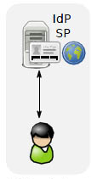
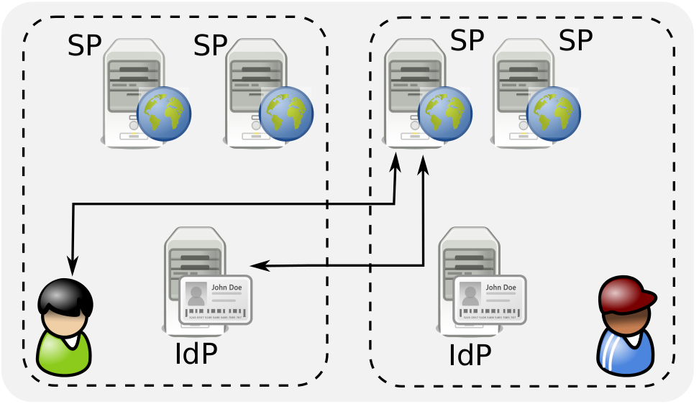
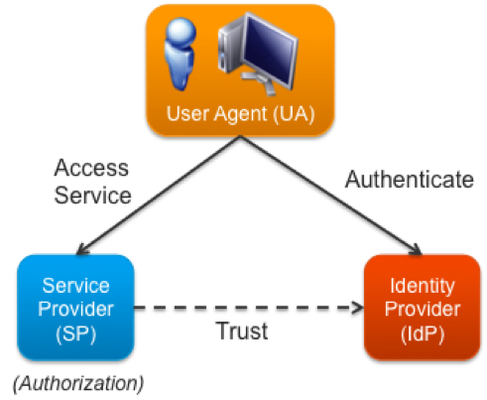
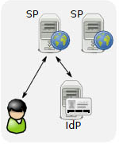
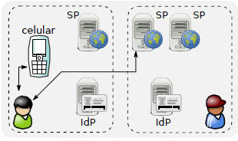
IdM Models
User x IdP x SP

Slide 59
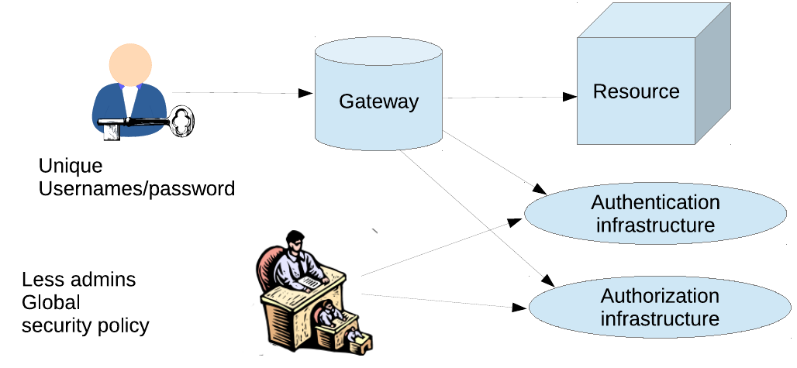
Privilege Management Infrastructure
Authentication and Access Control external to application

Slide 60
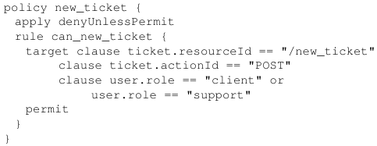
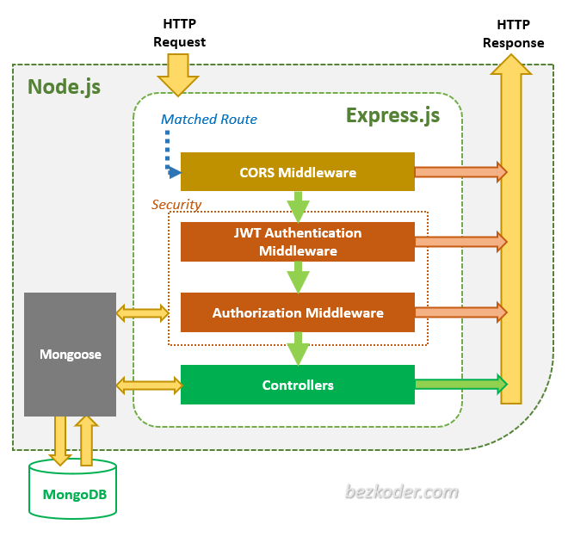
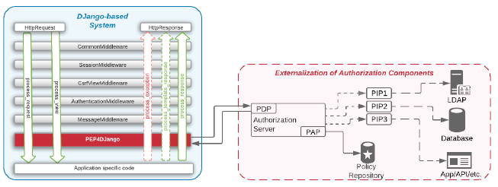
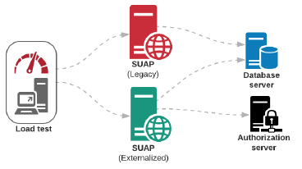
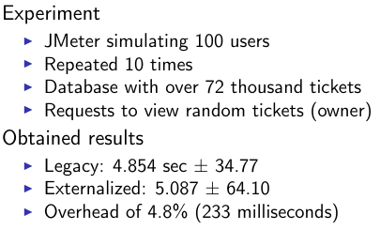
Example of these Concepts in Practice
https://www.bezkoder.com/node-express-vue-jwt-auth/
PEP4Django
da Silva, C. E., de Medeiros, W. R., & Sampaio, S. C.
PEP4Django—A policy enforcement point for python web applications.
IX Workshop de Gestão de Identidades Digitais (WGID), 2019.
https://sbseg2019.ime.usp.br/anais/197909.pdf
https://github.com/welkson/PEP4Django

Slide 61
Examples of tools
JSON Web Token
+ Express authorization middleware
Third party services
Auth0
Google Firebase
Cloud services
AWS Identity Services
Azure Identity and access management
Locally deployable services (e.g., docker)
Apache Keycloak
WSO2 Identity Service
Fiware AuthZForce
Notes:
https://www.bezkoder.com/node-express-vue-jwt-auth/

Slide 62

Carlos Eduardo da Silva (C.DaSilva@shu.ac.uk)

